Slide 1
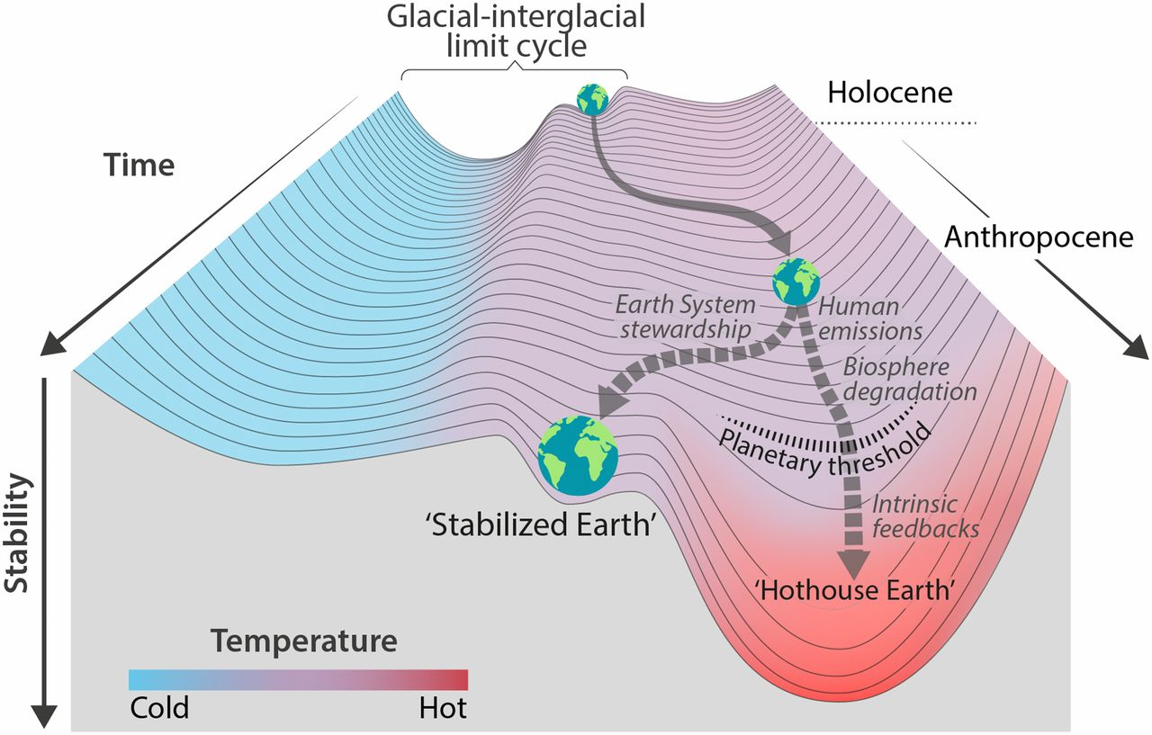
Recap: “Earth System Stewardship” formulated in Hothouse/Icehouse terms
*
‘Icehouse Earth’
We haven’t properly discussed the role of sea level rise in all this.
Steffen et al, PNAS 2018: https://www.pnas.org/content/115/33/8252

Slide 2
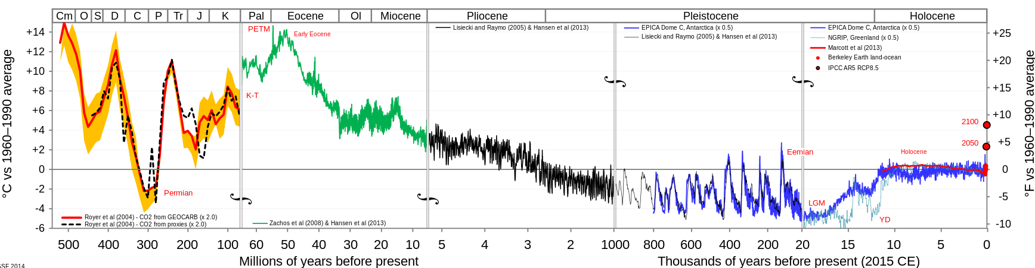
Remember last time, how the transition to “Icehouse Earth” involved the creation of lots of ice
time
Permanent ice in Greenland forms
Hothouse Earth
Icehouse Earth
Permanent ice forms in the East Antarctic
Northern Hemisphere ice sheets form and disappear The last time was 20,000 years ago.
The West Antarctic Ice Sheet (WAIS) forms and disappears; the last time was during the Eemian (and the Anthropocene is even warmer).

Slide 3
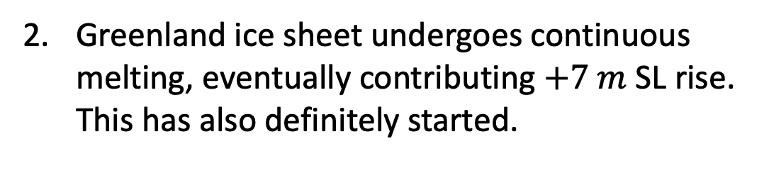
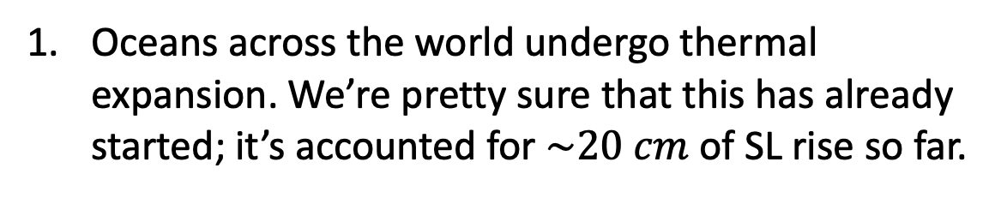
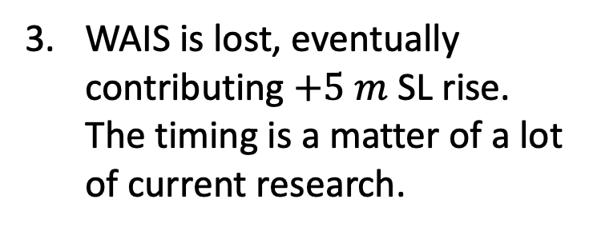
A likely path back to Hothouse Earth is to reverse the sequence of the last 50 million years
Greenland ice sheet undergoes continuous melting, eventually contributing $+7 m$ SL rise. This has also definitely started.
time
Hothouse Earth
Icehouse Earth
WAIS is lost, eventually contributing $+5 m$ SL rise. The timing is a matter of a lot of current research.
Oceans across the world undergo thermal expansion. We’re pretty sure that this has already started; it’s accounted for $\sim 20 cm$ of SL rise so far.

Slide 4


Even before ice sheets slip into the sea, we can expect thermal expansion – expansion from heating something (like the oceans)
However, bear in mind that sea level rise is not the same all over the world
$$∆h$$
$$h$$

Slide 5
Also bear in mind that what counts is not just the average for a given place, but the extra that happens during storms (“storm surges”)
$$∆h$$
$$h$$

Slide 6
What measurements say about this
https://www.bbc.com/news/science-environment-55022567

Slide 7
What measurements say about this
3-4 mm/year
https://www.bbc.com/news/science-environment-55022567

Slide 8
What measurements say about this
SL rise of 3-4 mm/year, thought to be mostly due to thermal expansion
SL rise of 4-5 mm/year, thought to be due to melting of land ice in addition to thermal expansion
https://www.bbc.com/news/science-environment-55022567

Slide 9
A lot of the land ice that’s melting is coming from Greenland

Slide 10
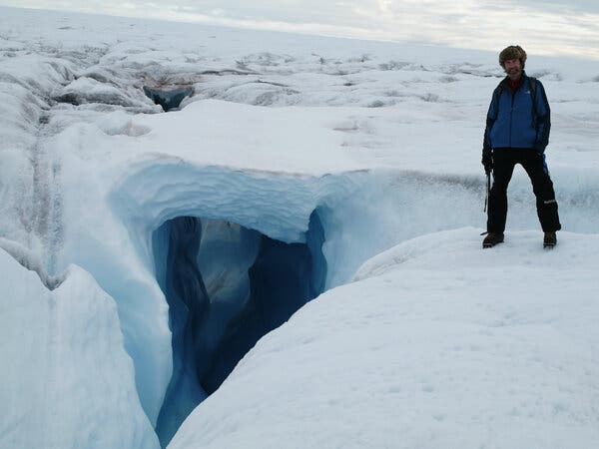
Konrad Steffen, 1952-2020
Notes:
Explore / Images of change/ … Africa’s Lake Kariba … Flooding in Sudan … Iceland … Lake Powell … Mississippi floods … Aculeo … Vavilov … Camp fire … Iowa flood … more Mississippi floods … Pine Island … Beach erosion … Hurricane damage in Florida

Slide 11
But SL rise from ice sheets is being increasingly felt
"If ice sheet losses continue to track our worst-case climate warming scenarios … that's enough to double the frequency of storm-surge flooding in many of the world's largest coastal cities.” - Dr Anna Hogg (Leeds)

Slide 12
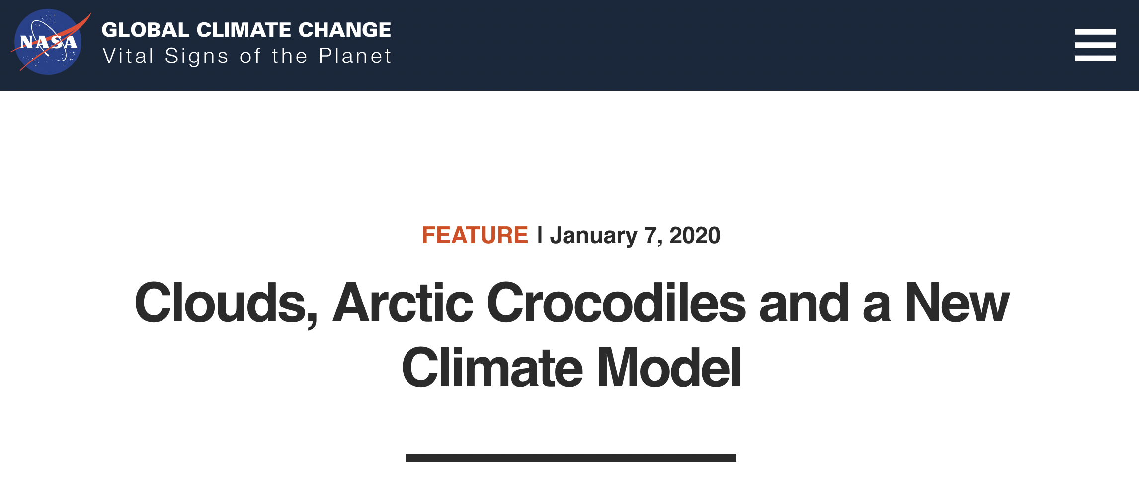
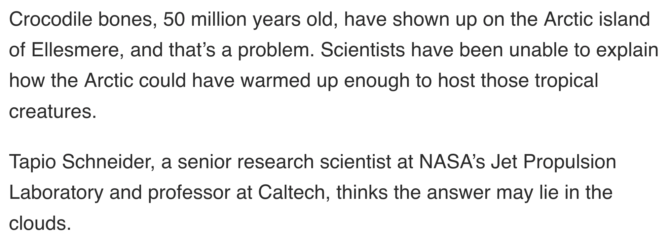
Two other mechanisms are more speculative because data are scarce: 1. Changes in clouds
https://climate.nasa.gov/news/2936/clouds-arctic-crocodiles-and-a-new-climate-model/

Slide 13

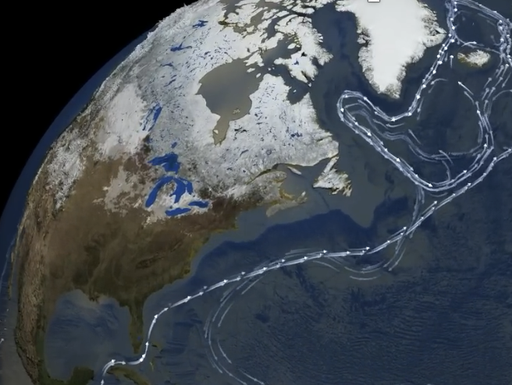
Two other mechanisms are more speculative because data are scarce: 2. Collapse of the AMOC
https://www.youtube.com/watch?v=jOVvXDI0KbY

Slide 14
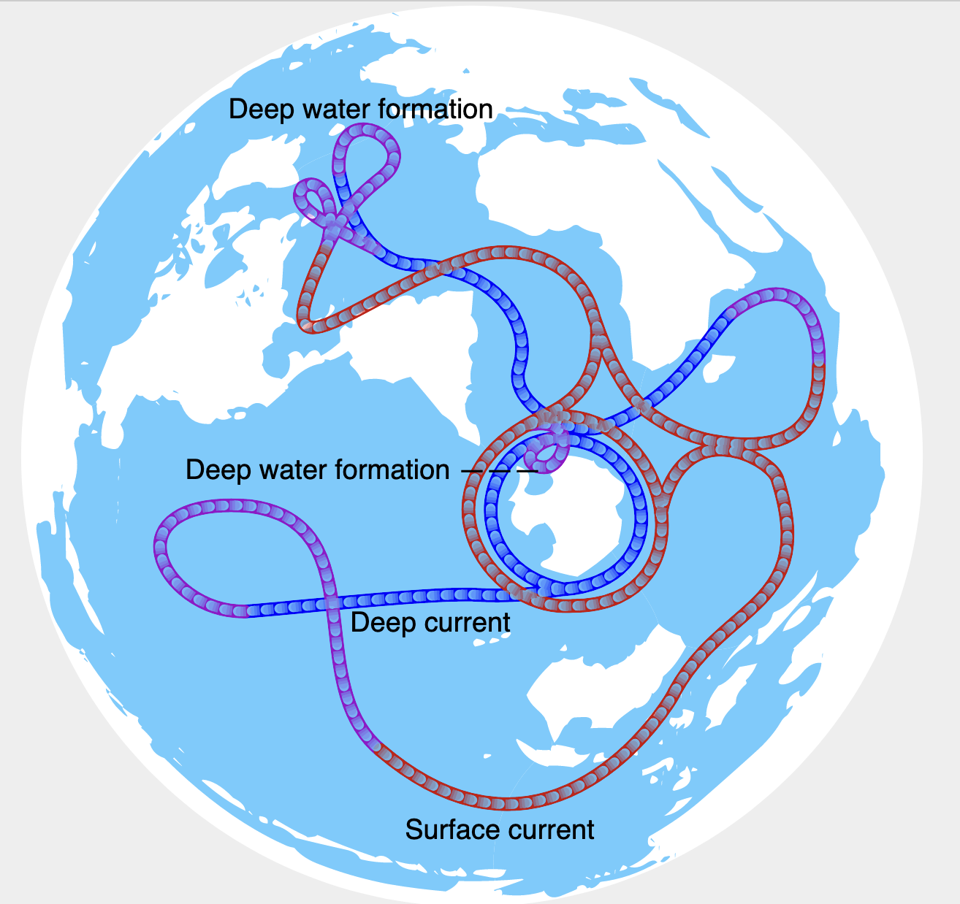
Apart from keeping North America and Europe warm, AMOC maintains a 1-meter hill of water in the North Atlantic ocean
https://upload.wikimedia.org/wikipedia/commons/a/ab/Thermohaline_circulation.svg

Slide 15
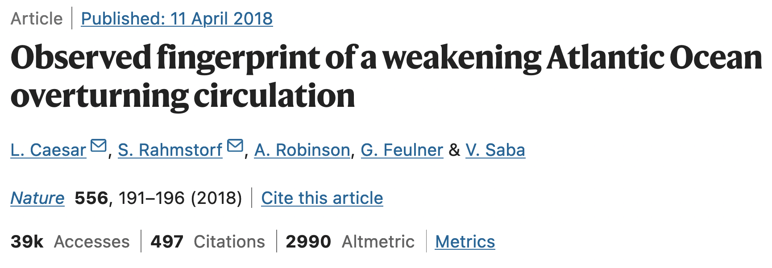
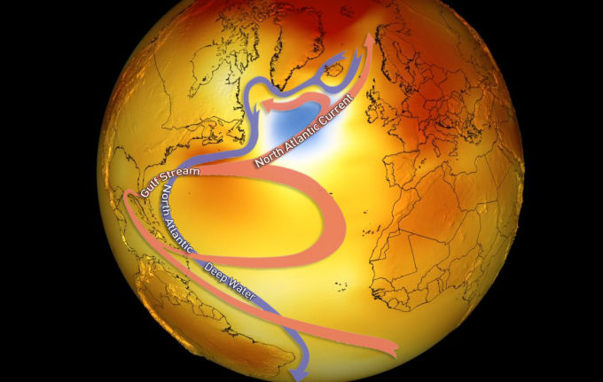
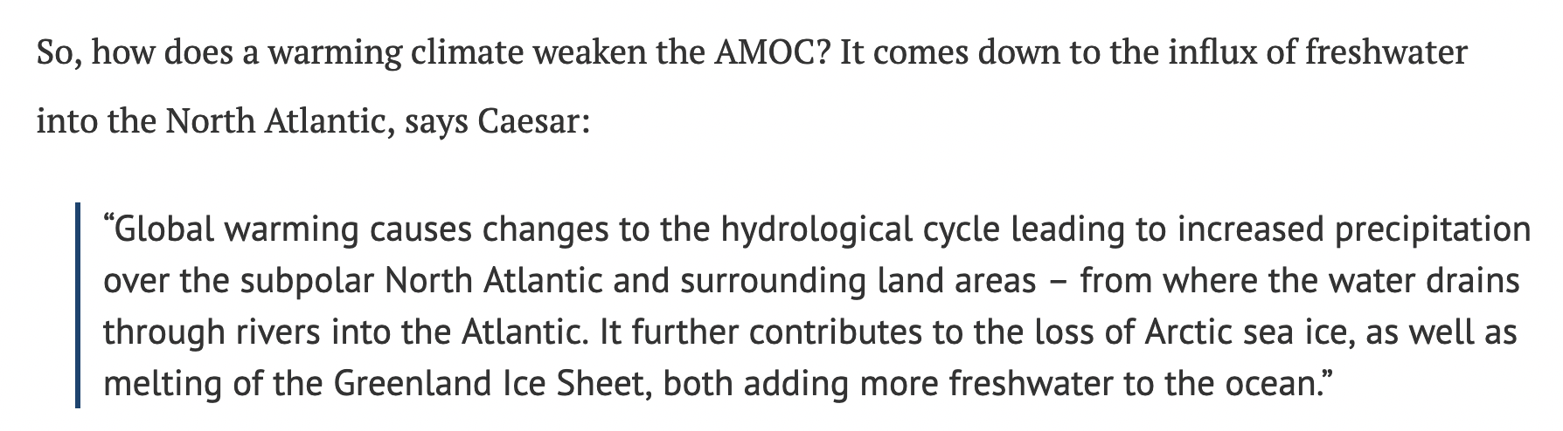
We think the AMOC is slowing down (via the “cold blob”)
https://www.carbonbrief.org/atlantic-conveyor-belt-has-slowed-15-per-cent-since-mid-twentieth-century/

Slide 16
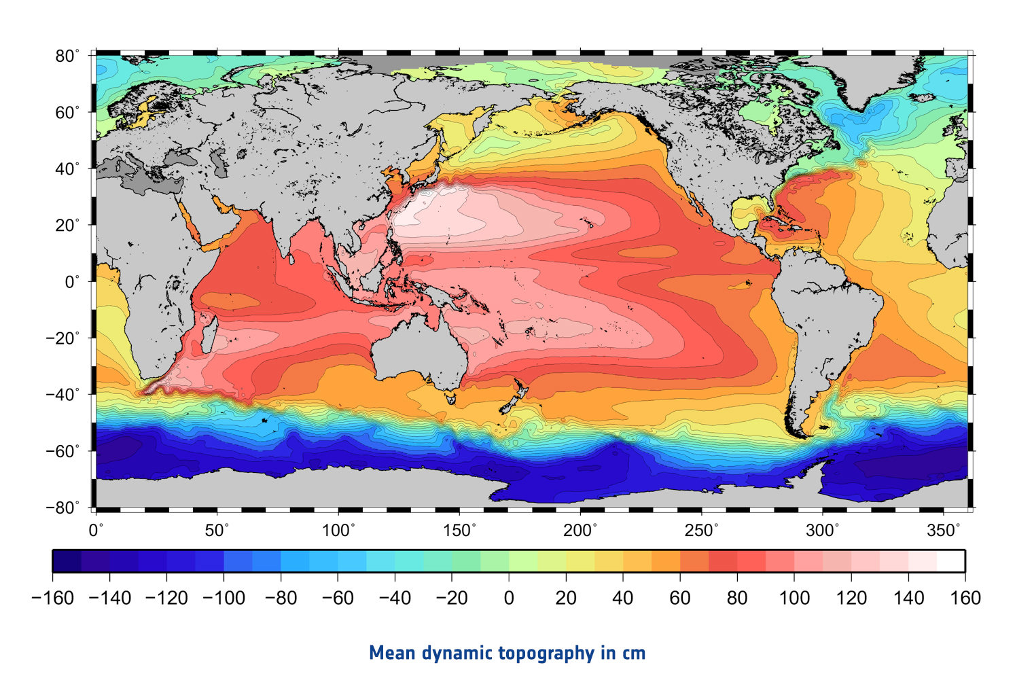
If/when it collapses, that hill of water will no longer be supported => sudden 1 m sea level rise
https://www.esa.int/ESA_Multimedia/Images/2014/11/Mean_dynamic_topography

Slide 17
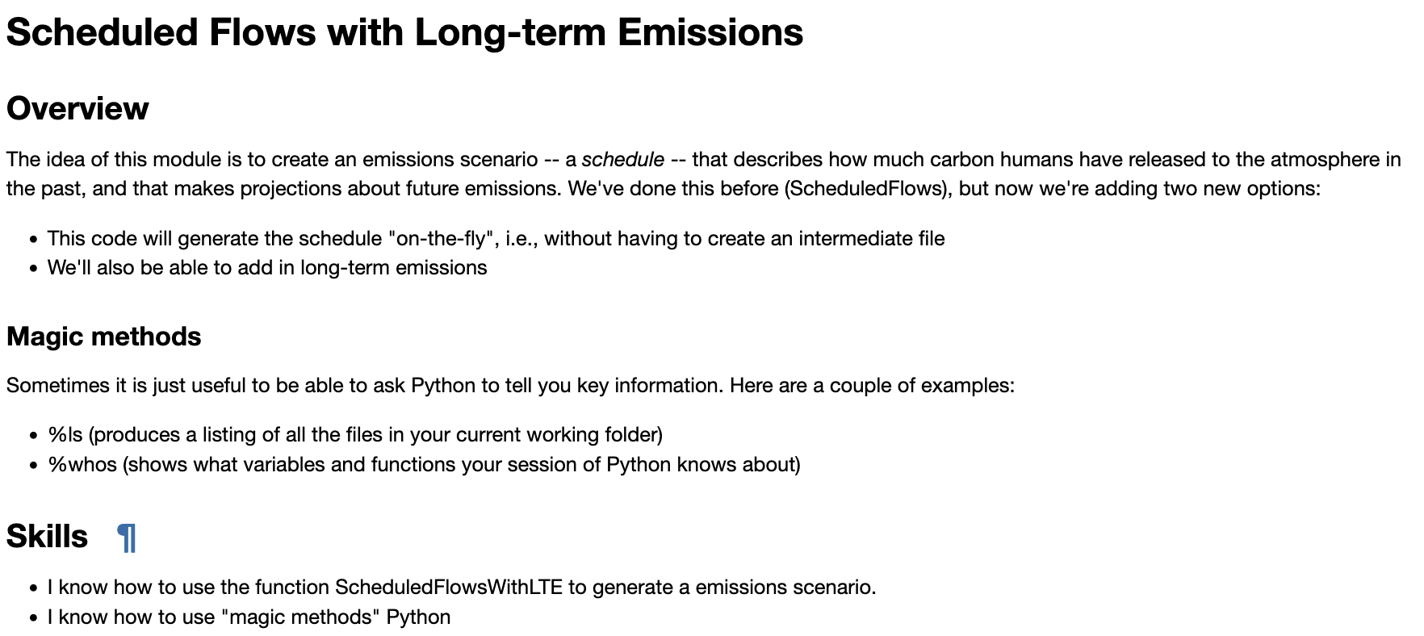
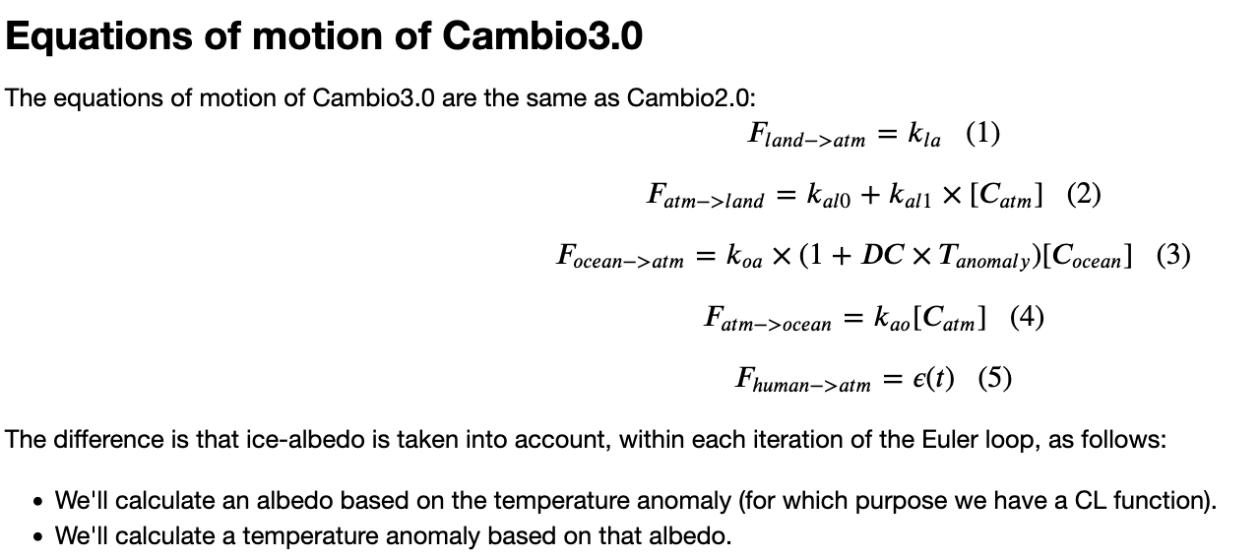
OK, let’s make some progress on these

